Slide 1
Introduction to the Issues
Week 1

Slide 2
Introduction
On March 13, 1964, a stalker repeatedly stabbed Kitty Genovese, then raped her as she lay dying out side her Queens, New York, apartment at 3:30 A.M. “Oh, my God, he stabbed me! Please help me!” Windows opened, and lights went on as neighbors – 38 of them as initially reported (later contested)- heard her screams. Her attacker fled and then returned to stab and rape her again. Not until he had fled for good did anyone so much as call the police, at 3:50 A.M.

Slide 3
Introduction
Andrew Mormille is knifed in the stomach as he rides the subway home. After his attackers leave the car, 11 other riders watch him bleed to death.

Slide 4
Introduction
A switchboard operator, working alone, is sexually assaulted. She momentarily escapes and runs naked and bleeding to the street and screams for help. Forty pedestrians watch as the rapist tries to drag her back inside. Two police officers who happened to be nearby stopped and arrested the assailant.

Slide 5
Introduction
“… construction worker Wesley Autry and his 6- and 4-year old daughters were awaiting a NYC subway train. Before hem a man collapsed in a seizure, got up, then stumbled to the platform’s edge and fell onto the tracks. With train headlights approaching, “I had to make a split decision,” Autry later recalled (Buckley, 2007). His decision, as his girls looked on in horror, was to leap from the platform, push the man off the tracks and into a foot-deep space between them, and lay atop him. As the train screeched to a halt, five cars traveled just above his head, leaving grease on his knit cap. When Autrey cried out, “I’ve got two daughters up there. Let them know their father is okay,” the onlookers erupted into applause.”

Slide 6
Introduction
Hearing the rumble of an approaching New York subway train, Everett Sanderson leapt down onto the tracks and raced toward the approaching headlights to rescue Michelle De Jesus, a four-year-old who had fallen from the platform. Three seconds before the train would have run her over, Sanderson flung Michelle into the crowd above. As the train approached, he himself failed in his first attempt to jump back to the platform, but was pulled by bystanders to safety just in time.

Slide 7
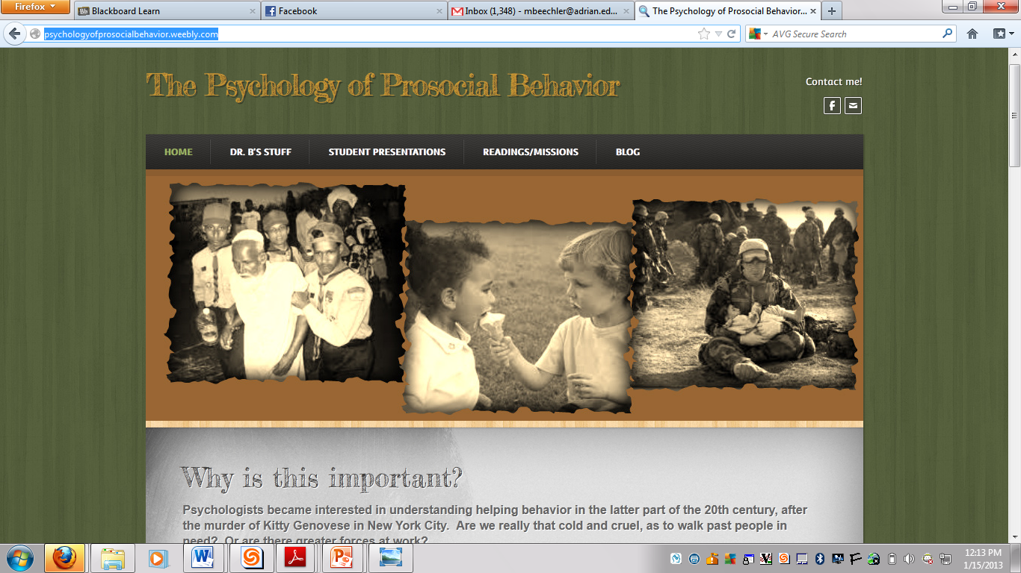
Course Website

Slide 8
Men do not value a good deed unless it brings a reward.
~Ovid

Slide 9
Some Definitions:
What does it mean for behavior to be prosocial?
What is a bystander?
What is altruism?
What is egoism?

Slide 10
Bystander Intervention
Bystander effect: a person is less likely to help when there are other bystanders present.

Slide 11
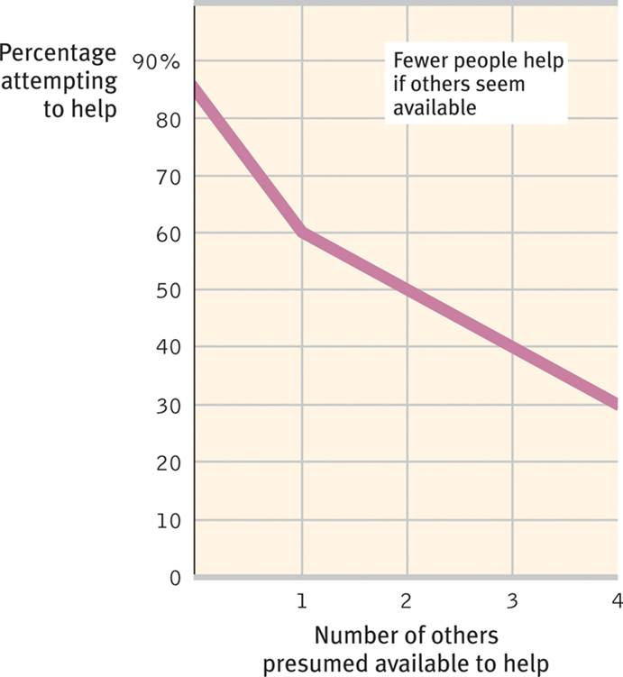

Slide 12
Bystander Intervention Model

Slide 13
Questions for this class
What situational factors influence prosocial behavior?
Is there such a thing as altruism?
Is there a prosocial personality type?

Slide 14
Questions for this class
Is there a biological or evolutionary basis for prosocial behavior?
How does prosocial behavior develop?
How is prosocial behavior socialized?

Slide 15
Questions for this class
How can we better understand and explain prosocial behaviors through integration of different approaches?
A complex problem is best solved by working together!

