Slide 1
Social-Cognitive Perspectives
Week 5

Slide 2
Social Norms
Oughts
Reciprocity Norm
Social Responsibility Norm

Slide 3
Reciprocity Norm
We should help (not harm) those that help us.
Especially strong for equals

Slide 4
Social-Responsibility Norm
People should help those who need help; people ought to help those dependent upon them.
Occurs even if helper is anonymous
Occurs even in absence of rewards
Closely tied to attributions

Slide 5
Barnes, Ickes & Kidd (1979)
Effects of the Perceived Intentionality and Stability of Another’s Dependency on Helping Behavior.

Slide 6
Barnes, Ickes & Kidd (1979)

Slide 7
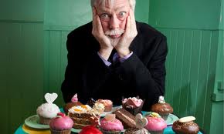
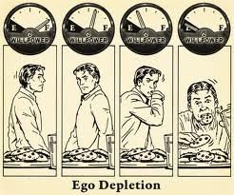
Self-Control

Slide 8
DeWall, Baumeister, Gailliot & Maner (2008)
Depletion Makes the Heart Grow Less Helpful: Helping as a Function of Self-Regulatory Energy and Genetic Relatedness

Slide 9
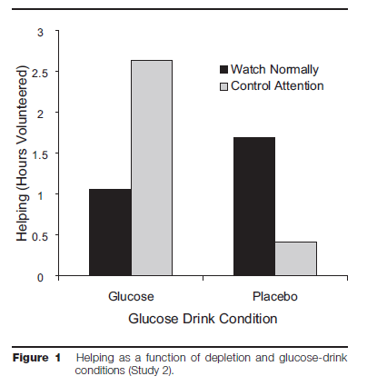
DeWall, et al. (2008)
Study 2

Slide 10
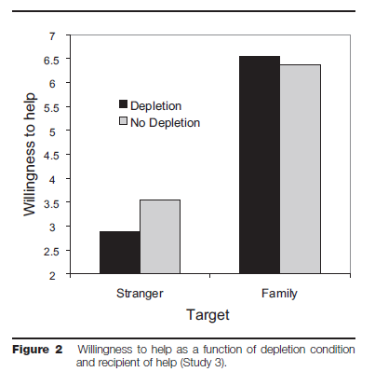
DeWall et al. (2008)
Study 3

Slide 11
Integration
Can we integrate Barnes, Ickes & Kidd’s research with Latane and Darley’s model?
Piliavin & Piliavin’s cost-reward model?

Slide 12
Integration
Can we integrate DeWall et al.’s (2008) study with the egoism-altruism debate research?

