Slide 1
Evolutionary Perspectives
Week 8

Slide 2
Altruism in Animals
Do you think animals can be altruistic?
Do your own pets show any altruistic tendencies?

Slide 3
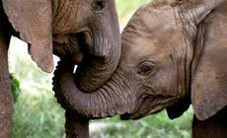
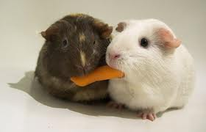
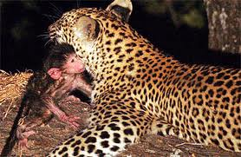
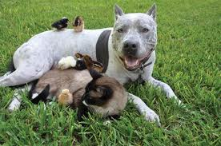
Altruism in Animals

Slide 4
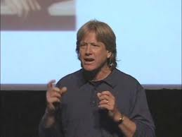
Evolutionary Psychology Perspectives
How did altruism evolve?
What evidence do we have?
http://www.youtube.com/watch?v=Shw1gQwBlNM
http://www.youtube.com/watch?v=KsFxWSuu_4I
http://www.youtube.com/watch?v=n8C-ntwUpzM

Slide 5
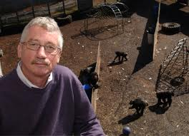
De Waal (2008)
Putting the Altruism Back in Altruism: The Evolution of Empathy

Slide 7
Poulin (2012)
Our Genes Want Us to Be Altruists

Slide 8
Evolutionary Perspectives
What do these articles say about the origins of altruism and morality in humans?

