Slide 1
Parenting and Prosocial Behavior
Week 10

Slide 2
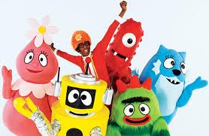
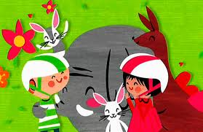
Social Learning and Prosocial Behavior
How is prosocial behavior socialized in children?

Slide 3
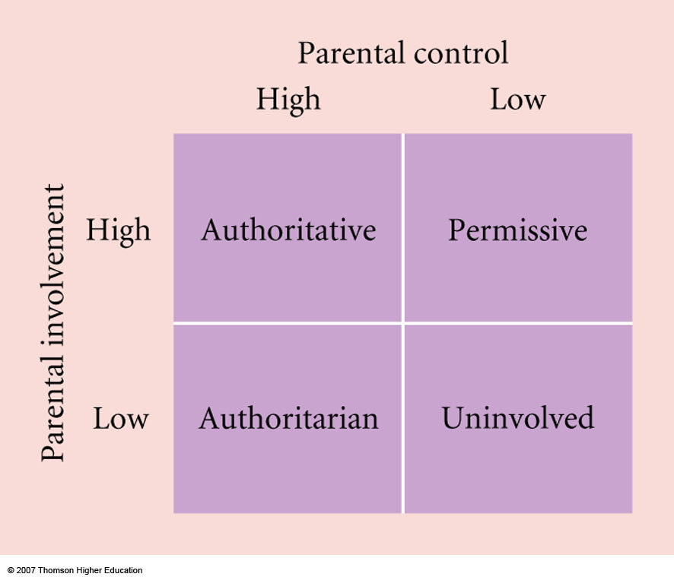
Social Learning: Parenting Styles

Slide 4
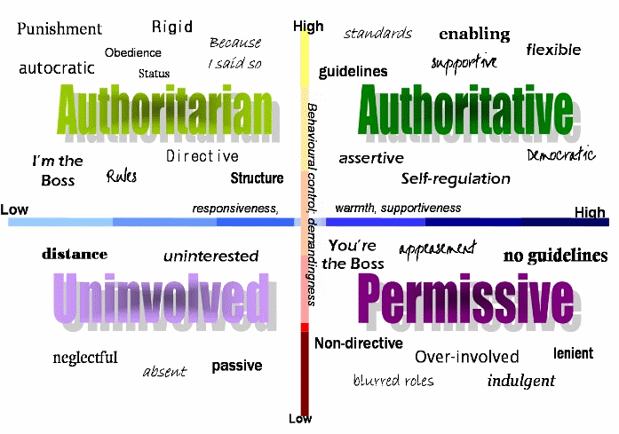
Social Learning: Parenting Styles

Slide 5
­­­­­­­­­­­­­­­­­­­­­­­The Relations of Parental Characteristics and Practices to Children’s Vicarious Emotional Responding
Eisenberg, Fabes, Schaller, Carlo, Miller (1991)

Slide 6
Parent’s Child-Rearing Style and Child’s Sociometric Status
Dekovic & Janssens (1992)

Slide 7
Sociometric Status
Popular children: frequently nominated as a best friend and are rarely disliked by their peers.
Average children: receive an average number of both positive and negative nominations from their peers.
Neglected children: infrequently nominated as a best friend but are not disliked by their peers.
Rejected children: infrequently nominated as a best friend and are actively disliked by their peers.
Controversial children: frequently nominated both as someone’s best friend and as being disliked.

Slide 8
Popular Children
Behaviors of popular children
Give out reinforcements
Listen carefully
Maintain open lines of communication with peers
Are happy
Control negative emotions
Show enthusiasm and concern for others
Self-confident without being conceited

Slide 9
Rejected Children
Behavior of rejected children
More likely to have adjustment problems than neglected children
Less likely to engage in classroom participation
More likely to express a desire to avoid school
More likely to report being lonely
Especially problematic when combined with aggression

Slide 10
Parenting Styles and Behavioral Outcomes
http://www.youtube.com/watch?v=0EvggSCMixU
http://www.youtube.com/watch?v=X7gsNCTFby0
http://www.youtube.com/watch?v=LYVvPNvZhE0

