Slide 1
Social Perspectives on Prosocial Behavior
Week 2

Slide 2
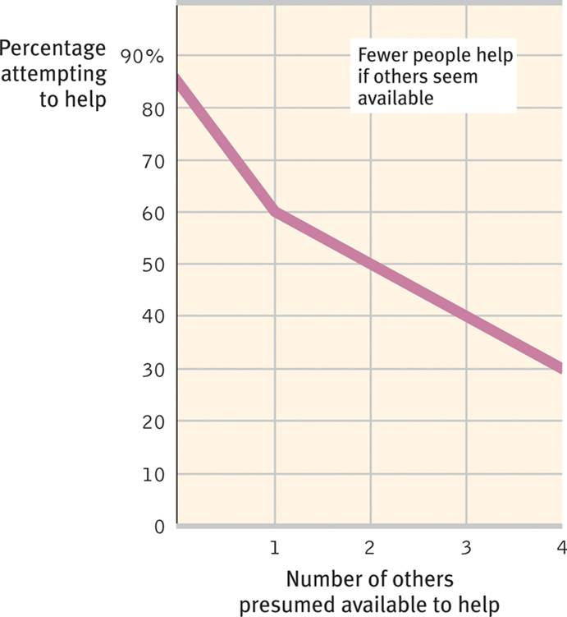
When do we help?
The Bystander Intervention Model

Slide 3
Darley & Latane (1968) Bystander Intervention Model

Slide 4
Darley & Latane (1968) Bystander Intervention Model
Notice the incident
What may keep us from noticing an emergency?

Slide 5
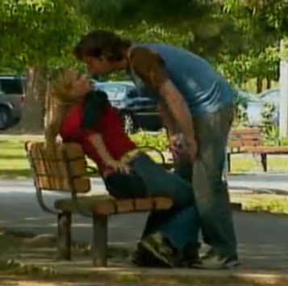
Darley & Latane (1968) Bystander Intervention Model
Interpret as an emergency
What may keep us from interpreting an event as an emergency?

Slide 6
Darley & Latane (1968) Bystander Intervention Model
Assumes responsibility
What may keep us from assuming responsibility in an emergency?

Slide 7
When do we help?
Situational influences
What happens if we see someone else act prosocially?

Slide 8
When do we help?
Situational influences
How does time play a role in helping?

Slide 9
When do we help?
Situational influences
Feelings
Guilt
Negative mood
Positive mood

Slide 10
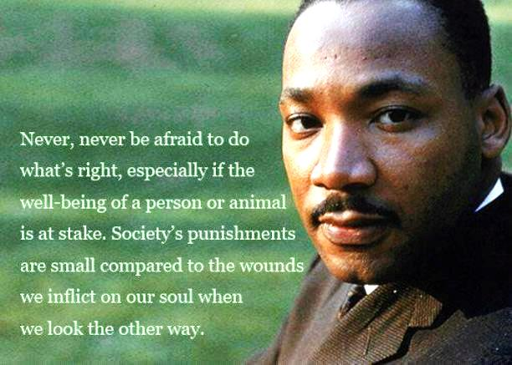
Why Do We Help?

Slide 11
Why do we help?
Social exchange
External
Internal

Slide 12
MISSION 1
Put mission here – talk about it.

Slide 13
Piliavin, Piliavin & Rodin (1975)
Costs, Diffusion, and the
Stigmatized Victim

Slide 14
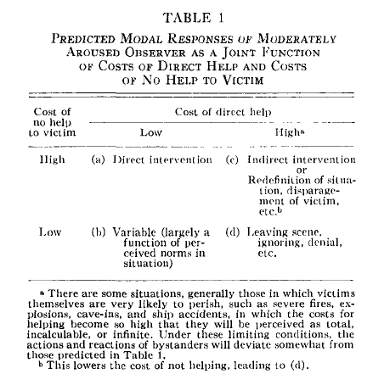

Slide 15
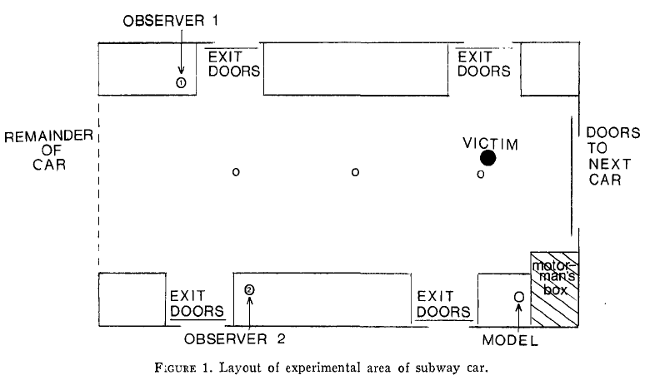

Slide 16
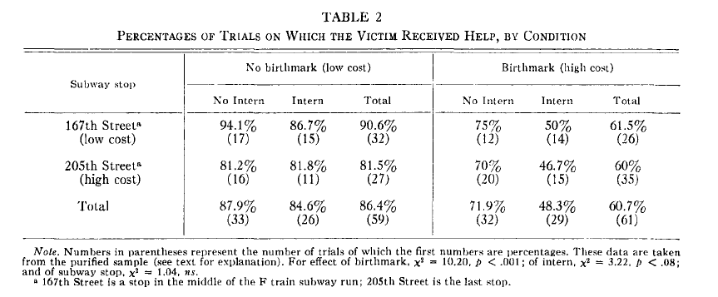

Slide 17
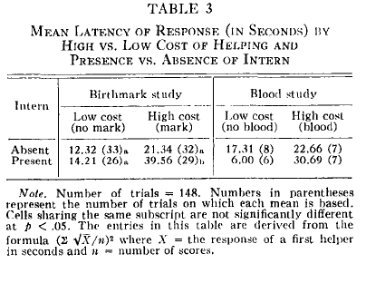

Slide 18
Major Findings
_____________________________________
______________________________________

Slide 19
Integration

