Slide 1
Social Perspectives on Prosocial Behavior: The Egoism-Altruism Debate
Week 3

Slide 2
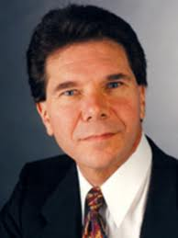
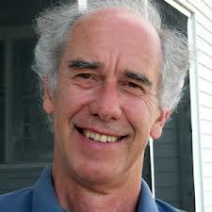
Egoism-Altruism Debate
Daniel Batson
Robert Cialdini

Slide 3
Egoism-Altruism Debate
Altruism: motivational state in which the ultimate goal is increasing a victims’ welfare
Egoism: motivational state in which the ultimate goal is increasing one’s own welfare

Slide 4
Egoistic Hypotheses
“Men do not value a good deed unless it brings a reward.”
-Ovid, Epistulae ex Ponto

Slide 5
Reward Seeking/Punishment Avoiding Egoistic Motivation
Individual uses the need situation to gain rewards or avoid punishments
Empathy-specific rewards hypotheses
Empathy-specific punishments
Arousal cost-reward model

Slide 6
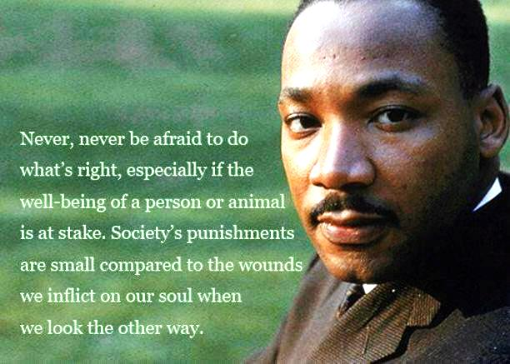
Empathy-Specific Punishments

Slide 7
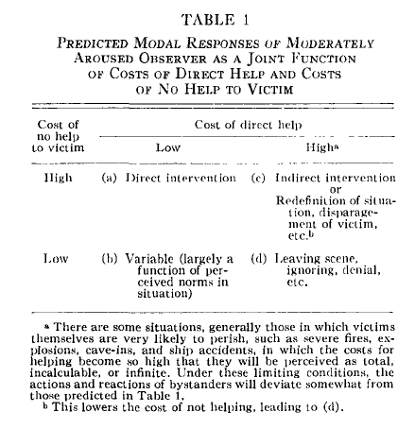
Piliavin et al. (1975)

Slide 8
Altruism Hypotheses
“How selfish soever man may be supposed, there are evidently some principles in his nature, which interest him in the fortune of others, and render their happiness necessary to him, though he derives nothing from it except the pleasure of seeing it.”
-Adam Smith
The Theory of Moral Sentiments, 1759

Slide 9
Empathy-Altruism Hypothesis
When a bystander encounters another individual in need, the bystander may feel empathy.
Empathy is vicarious emotional responding with a focus on another person’s welfare
Empathy leads to altruism

Slide 10
Batson, Dyck, Brandt, Batson, Powell, McMaster & Griffitt (1988)
Five Studies Testing Two New Egoistic Alternatives to the Empathy-Altruism Hypothesis

Slide 11
EGOISM: Negative-State Relief Hypothesis
People who feel empathy for are motivated by the relief of their own sadness.
Helping is gratifying and people will be motivated to help when in a bad mood because they believe it will make them feel good.

Slide 12
Cialdini, Schaller, Houlihan, Arps, Fultz & Beamon (1987)
Empathy-Based Helping: Is it Selflessly or Selfishly Motivated?

Slide 13
Negative-State Relief Hypotheses
Inconsistent support
Expected mood enhancement did not decrease helping for individuals in a high-empathy situation (Batson et al., 1989)
Empathy predicts helping even with the potentially mediating effects of sadness in the model (Dovidio et al., 1990)

Slide 14
MOTIVES: Emotional Responses
Sadness
Personal distress
Empathy

Slide 15
???
Egoistic
Distress
Other’s Distress
Empathy
Altruistic
HELP

Slide 16
Felt-Oneness Hypothesis
Felt-oneness as an additional egoistic motivation(Cialdini et al., 1997)
If bystander takes victims perspective, or has an attachment to the victim, then the bystander experiences Oneness,
A sense of shared, merged, or interconnected personal identities

Slide 17
MOTIVES: Emotional Responses
Sadness
Personal distress
Empathy
Felt-Oneness

Slide 18
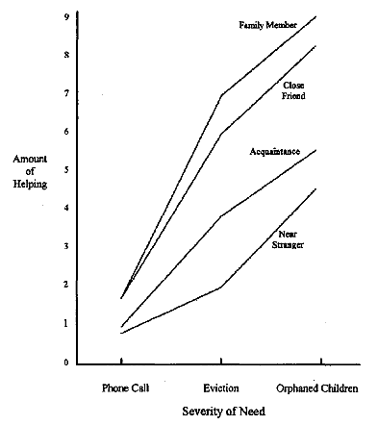

Slide 19
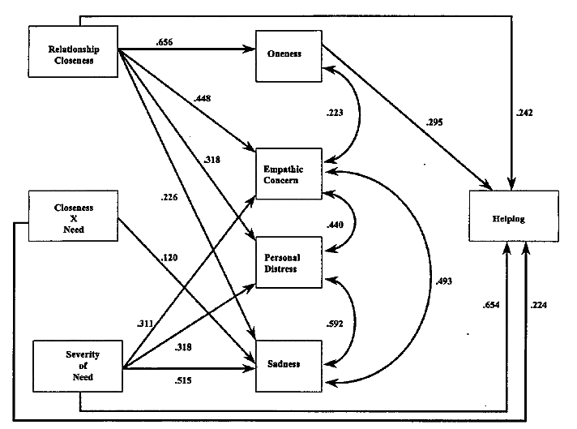

Slide 20
Felt-Oneness vs. Empathy-Altruism Hypothesis
Felt Oneness:
Cialdini et al. (1997)
Maner et al. (2002)
Empathy-Altruism
Batson et al. (1997)
Batson et al. (2003)

Slide 21
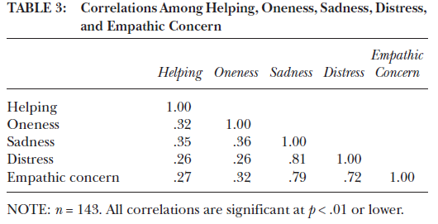
Felt-Oneness vs. Empathy-Altruism Hypothesis
Maner et al. (2002)

Slide 22
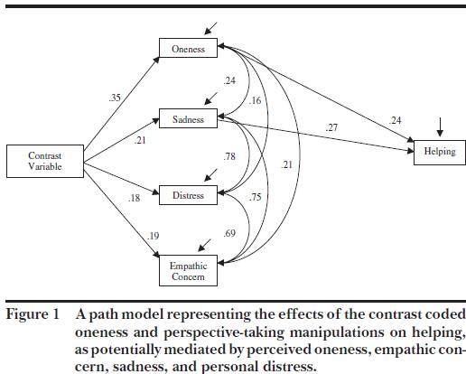

Slide 23
