Slide 1
Social Perspectives Empathy Altruism vs. Felt Oneness
Week 4

Slide 2
Negative-State Relief Hypotheses
Inconsistent support
Expected mood enhancement did not decrease helping for individuals in a high-empathy situation (Batson et al., 1989)
Empathy predicts helping even with the potentially mediating effects of sadness in the model (Dovidio et al., 1990)
Empathy predicts helping, even in the absence of possibility for negative social evaluation (Fultz et al., 1986).

Slide 3
Empathy-Altruism Hypothesis
When a bystander encounters another individual in need, the bystander may feel empathy.
Empathy is vicarious emotional responding with a focus on another person’s welfare
Empathy leads to altruism

Slide 4
Felt-Oneness Hypothesis
Felt-oneness as an additional egoistic motivation(Cialdini et al., 1997)
If bystander takes victims perspective, or has an attachment to the victim, then the bystander experiences Oneness,
A sense of shared, merged, or interconnected personal identities

Slide 5
MOTIVES: Emotional Responses
Sadness
Personal distress
Empathy
Felt-Oneness

Slide 6
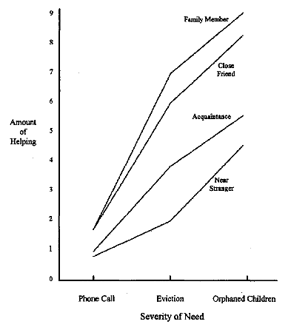

Slide 7
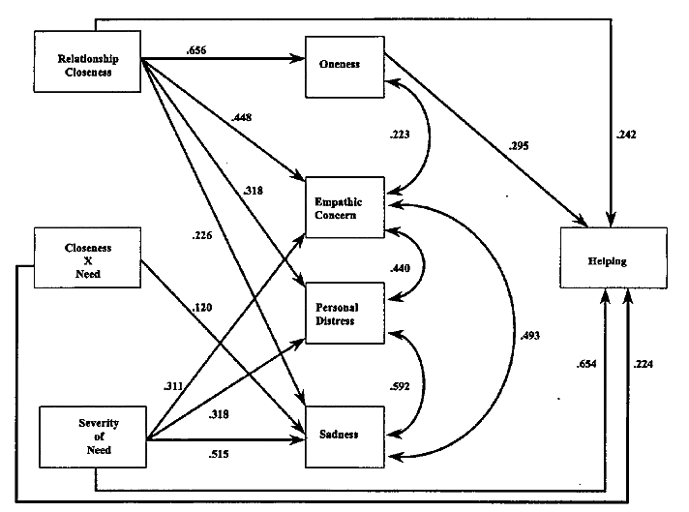

Slide 8
Felt-Oneness vs. Empathy-Altruism Hypothesis
Felt Oneness:
Cialdini et al. (1997)
Maner et al. (2002)
Empathy-Altruism
Batson et al. (1997)
Batson et al. (2003)
Batson et al. (2005)

Slide 9
Felt-Oneness vs. Empathy-Altruism Hypothesis
Batson et al. (1997)
Criticized methodology of Cialdini et al.’s (1997) study.
No measures of self-other overlap accounted for the relationship between empathy and helping

Slide 10
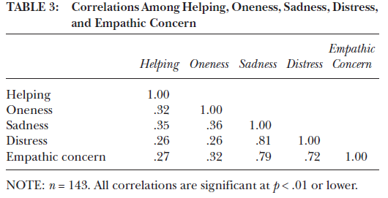
Felt-Oneness vs. Empathy-Altruism Hypothesis
Maner et al. (2002)

Slide 11
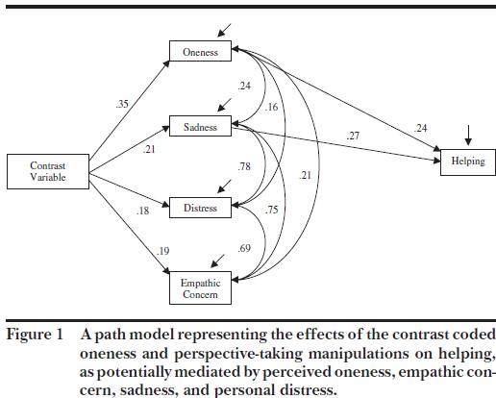

Slide 12
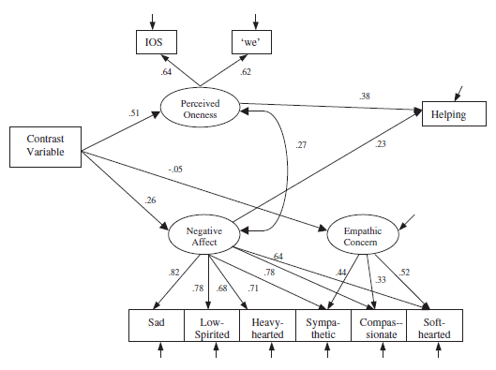

Slide 13
Felt-Oneness vs. Empathy-Altruism Hypothesis
Batson et al. (2003)
Perspective taking
Imagine how another individual feels…
Imagine how you would feel…
Effect reduced under conditions of great disparity between self and other’s position

Slide 14
Felt-Oneness vs. Empathy-Altruism Hypothesis
Batson et al. (2005)
Nurturance hypothesis
Empathy is an impulse to care and protect one’s young
Humans can generalize this to non-kin
Strength of impulse varies by severity of situation
Empathy felt for strangers may be due to nurturance, in which helper views victim as requiring some need or protection.

Slide 15
Maner & Gailliot (2007)
Altruism and Egoism: Prosocial Motivations for Helping Depend on Relationship Context

Slide 16
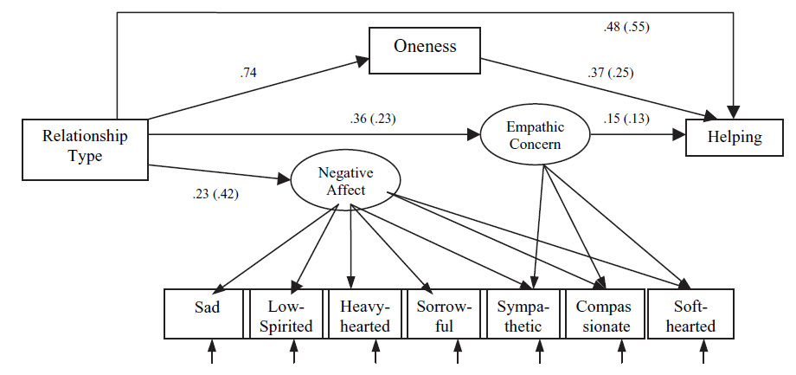
Felt-Oneness vs. Empathy-Altruism Hypothesis

Slide 17
Felt-Oneness vs. Empathy-Altruism Hypothesis

Slide 18
Putting it Together
Complex relationship between helper, victim, situation, and relationship context
Victim is Stranger
Regular Person: helping by felt-oneness
Cute baby: helping by empathy due to nurturance
Victim is Close Relationship
Empathy → Helping
Severity of Need

Slide 19
Beechler (2011)
A Bioecological Approach to Empathy, Altruism and Intent to Help:
Developmental, Dispositional and Contextual Factors Influence Prosocial Motivations and Intentions

Slide 20
Procedure
Development
Disposition
Completed 1 of 10 Conditions:
Severity / Closeness / Nurturance / Antipathy
Intent to Help
Oneness
Emotional Response

Slide 21
Conditions
Near Stranger/Close Relationship
Child/ Adult
Severity:
LOW: “Imagine that the child’s parents are without a vehicle, and the child needs to be driven to school. The child’s home and school is within a short driving distance of your home. Please choose the highest form of aid you would provide.”
HIGH: “Imagine he or she had been killed in an auto accident, and his or her child is left with no one to care for them. Please choose the highest form of aid you would provide.”

Slide 22
Conditions – 2X2X2 Factorial Design
LOW SEVERITY OF NEED – CAR SCENARIO:
HIGH SEVERITY OF NEED – ORPHAN SCENARIO:
Low Nurturance High Nurturance
Low Closeness
High Closeness
Stranger from class | Child they do not know
Close friend | Child in their family
Low Nurturance High Nurturance
Low Closeness
High Closeness
Stranger from class | Child they do not know
Close friend | Child in their family
Notes:
This is the experimental design within my model. This is a 2 X 2 X 2 Factorial design
Three IV’s (nurturance, closeness, severity of need) each with 2 levels. This will make a total of 8 different conditions.
Can look at the main effects of nurturance, closeness and need.
Can look at interactions as well
-Closeness x Severity
-Closeness x Nurturance
-Nurturance x Severity
-Nurturance x Severity x Closeness

Slide 23
Conditions – 2X2 Factorial Design
ANTIPATHY X SEVERITY OF NEED
“Imagine someone you know but strongly dislike…”
Low Antipathy High Antipathy
Low Severity
High Severity
All Previous Low Severity | Someone they disliked
All Previous High Severity | Someone they disliked
Notes:
This is the experimental design within my model. This is a 2 X 2 X 2 Factorial design
Three IV’s (nurturance, closeness, severity of need) each with 2 levels. This will make a total of 8 different conditions.
Can look at the main effects of nurturance, closeness and need.
Can look at interactions as well
-Closeness x Severity
-Closeness x Nurturance
-Nurturance x Severity
-Nurturance x Severity x Closeness

Slide 24
Measures - Outcomes
Intent to help
Low severity - car scenario
“Nothing” – “Give ride to school/work for several months”
High severity – orphan scenario
“Nothing” – “Raise child as your own”
Weighted*
*Cialdini et al. (1997)

Slide 25
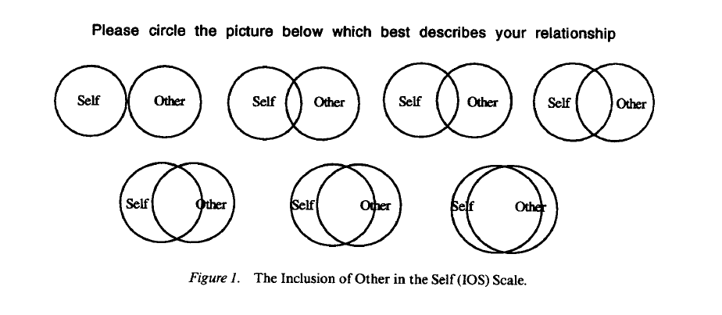
Measures - Outcomes
Inclusion of Other in Self Scale*
*Aron et al. (1992)

Slide 26
Measures - Outcomes
Emotional response scale*
Empathy
Sympathetic, touched, softhearted, compassionate
Personal distress
Distressed, disturbed, troubled, uneasy
Sadness
Low-spirited, heavy-hearted, sad, feeling low
α‘s = .88 - .93
*see Fultz et al. (1988)

Slide 27
DEVELOPMENT DISPOSITION CONTEXT OUTCOMES
WDRAW TEMP.
ONENESS
EMPATHY
REL. CLOSE
PARENT SUPPORT
EMPATHY
PERSONAL DISTRESS
PARENT PUNISH
INTENT TO HELP
NURTURE
PERS. TAKING
PARENT-CHILD EXPECT
SADNESS
PARENT CONTROL
SEVERITY
HELPFUL
ANTIPATH
MORAL REASONING COMPOSITE
PERSONAL DISTRESS
χ² (95, N = 339) = 123.96, p < .01; CFI = .97, RMSEA = .04
Notes:
This is the model that will actually be tested using path analysis.
So, the paths are the specific predictions, and those are given by the arrows.
Now, the path analysis is going to give me some results.
Overall model fit. Overall, how well is the overall model supported by the data?
Prediction of variables. It will tell me which variables are significant predictors.
Structural model. It will tell me how the model looks with all the variables tested – the relationships, whether any variables should be left out.

Slide 28
DEVELOPMENT DISPOSITION CONTEXT OUTCOMES
ONENESS
REL. CLOSE
EMPATHY
NURTURE
SADNESS
SEVERITY
ANTIPATHY
PERSONAL DISTRESS
Notes:
This is the model that will actually be tested using path analysis.
So, the paths are the specific predictions, and those are given by the arrows.
Now, the path analysis is going to give me some results.
Overall model fit. Overall, how well is the overall model supported by the data?
Prediction of variables. It will tell me which variables are significant predictors.
Structural model. It will tell me how the model looks with all the variables tested – the relationships, whether any variables should be left out.

Slide 29
DEVELOPMENT DISPOSITION CONTEXT OUTCOMES
REL. CLOSE
INTENT TO HELP
SEVERITY
Notes:
This is the model that will actually be tested using path analysis.
So, the paths are the specific predictions, and those are given by the arrows.
Now, the path analysis is going to give me some results.
Overall model fit. Overall, how well is the overall model supported by the data?
Prediction of variables. It will tell me which variables are significant predictors.
Structural model. It will tell me how the model looks with all the variables tested – the relationships, whether any variables should be left out.

Slide 30
DEVELOPMENT DISPOSITION CONTEXT OUTCOMES
ONENESS
EMPATHY
INTENT TO HELP
Notes:
This is the model that will actually be tested using path analysis.
So, the paths are the specific predictions, and those are given by the arrows.
Now, the path analysis is going to give me some results.
Overall model fit. Overall, how well is the overall model supported by the data?
Prediction of variables. It will tell me which variables are significant predictors.
Structural model. It will tell me how the model looks with all the variables tested – the relationships, whether any variables should be left out.

Slide 33
PERSON EFFECTS
DEVELOPMENT DISPOSITION CONTEXT OUTCOMES
TEMPERAMENT
PROSOCIAL DISPOSITIONS
Context
Context
RELATIONSHIP CLOSENESS
SEVERITY OF NEED
ANTIPATHY
PERSONAL DISTRESS
SADNESS
INTENT TO HELP
TIME
SOCIALIZATION
HISTORY
MORAL REASONING
ONENESS
SITUATIONAL EMPATHY
TIME
HELPFULNESS
NURTURANCE
X RELATIONSHIP CLOSENESS
Notes:
My specific hypotheses are also inherent within the model.
1) I expect my overall model to be supported.
2) Developmental person effects → dispositional person effects
Dispositional person effects → outcomes
Context, situational factors → the outcomes
3) Each of these factors belong in the model – person effects, context, over time.

Slide 34
Conclusions
Nurturance
Weakens effect of relationship closeness
Why?
Less variability in imagined child victim?
Low control in who participants imagined.
Less experience with children → less effects?
Imagined need scenario?
Fear of responsibility?
When does/doesn’t nurturance matter?
Does it really evoke empathy?

Slide 35
Conclusions
Antipathy
Has its own main effects and interactions
Less empathic
Less oneness
Less help!
Assertion by Batson that antipathy may be confounded with oneness is not supported
These operate separately

