Slide 1
Personality Perspectives
Week 6

Slide 2
“There are… reasons why personality should be rather unimportant in determining people’s reactions to the emergency. For one thing, the situational forces affecting a person’s decision are so strong.”
-Latane & Darley (1970, p. 115)

Slide 3
Is there such a thing?
Is there a prosocial personality?
How do you know?

Slide 4
Rushton, Chrisjohn, & Fekken
The Altruistic Personality and the Self-Report Altruism Scale

Slide 5
Self-Report Altruism Scale
Why did most researchers believe that there was no altruistic personality?
“…just about everyone will help in some situations; just about nobody will help in other contexts; and the same people who help in some situations will not help in others” (Krebs, 1978)
Personality research on altruism is a … “quagmire of evanescent relations among variables, conflicting findings, and low order correlation coefficients’(Gergen et al., 1972).

Slide 6
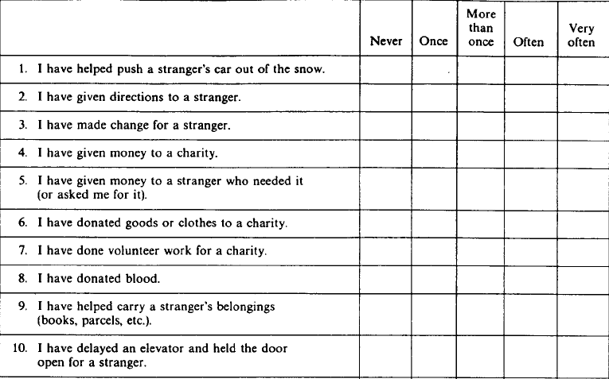

Slide 7
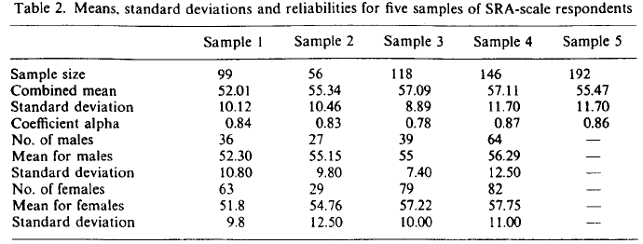
Self-Report Altruism Scale: Comparing Scores

Slide 8
Archer, Diaz-Loving, Gollwitzer, Davis, & Foushee
The Role of Dispositional Empathy and Social Evaluation in the Empathic Mediation of Helping

Slide 9
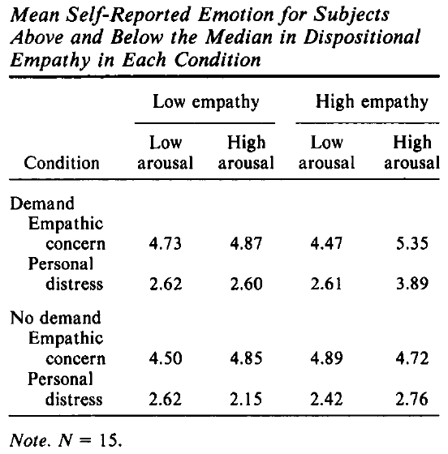

Slide 10
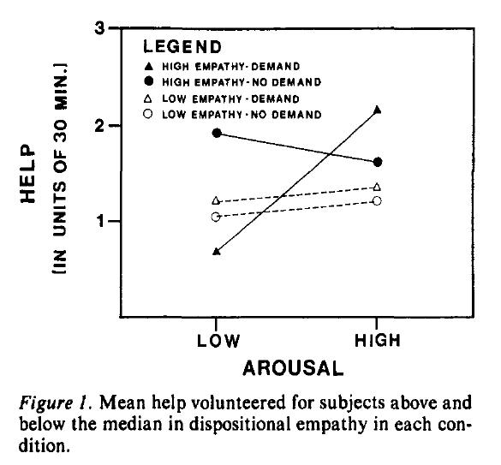

Slide 11
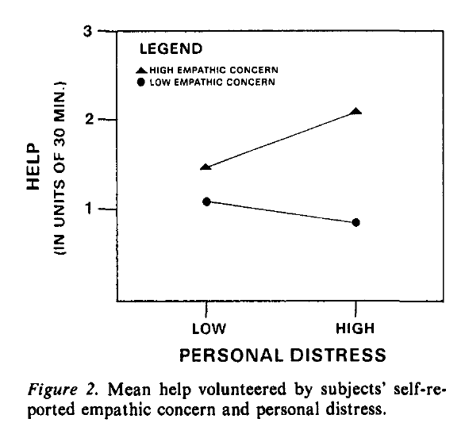

Slide 12
Integration
Can we integrate Rushton et al.’s research with any others we have talked about so far?
What about Archer et al.’s study?

