Slide 1
The Components of a Prosocial Personality
Week 7

Slide 2
Today
Prosocial personality measures
The components of prosocial personality
Penner’s PSB – Article Summary
Comparing your findings
Beechler (2011) dissertation findings
Missions

Slide 3
Components of Prosocial Personality
What types of characteristics are found in people who are more prosocial or altruistic?
What types of behaviors are characteristic of people who are more prosocial or altruistic?

Slide 4
Penner, Fritzsche, Craiger, & Freifeld
Measuring the Prosocial Personality

Slide 5
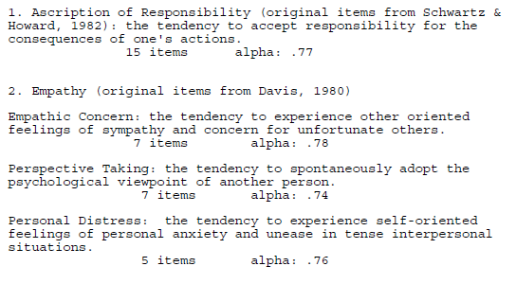
Penner et al. (1995)

Slide 6
Penner et al. (1995)

Slide 7
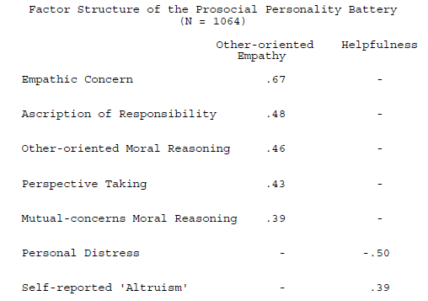
Penner et al. (1995)

Slide 8
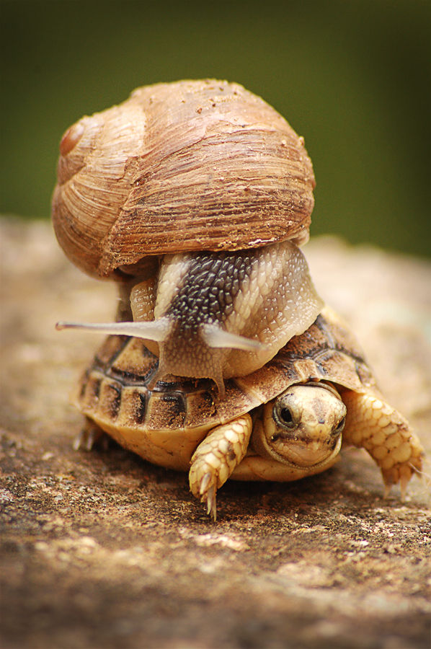
Prosocial Dispositions
Two factors to prosocial
personality*
Prosocial affect and cognitions
Empathic concern
Ascription of responsibility
Perspective taking
Other-oriented moral reasoning
Group-oriented moral reasoning
Prosocial Behaviors
Helpfulness
Personal Distress (-)
*Penner et al., 1995

Slide 9
Prosocial Dispositions
Stability in prosocial dispositions*
Across Time
Childhood → young adulthood
Across Context
Multiple raters
*Eisenberg et al., 2002

Slide 10
Measures - Disposition
Interpersonal Reactivity Index*
Perspective taking
“I believe that there are two sides to every question and try to look at them both.”
Empathic concern
“I am often quite touched by things that I see happen.”
Personal distress
“When I am with a friend who is depressed, I become so uncomfortable that I can’t really talk to him.”
α’s = .68 - .77
*Davis (1983)

Slide 11
Measures - Disposition
Self-Report Altruism Scale*
“I have given money to a charity.”
α’s = .78 - .87
Social Desirability Scale**
“I have never intensely disliked someone.”
α = .88
*Rushton et al. (1981)
**Crowne & Marlowe (1960)

Slide 12
DEVELOPMENT DISPOSITION CONTEXT OUTCOMES
WDRAW TEMP.
ONENESS
EMPATHY
REL. CLOSE
PARENT SUPPORT
EMPATHY
PERSONAL DISTRESS
PARENT PUNISH
INTENT TO HELP
NURTURE
PERS. TAKING
PARENT-CHILD EXPECT
SADNESS
PARENT CONTROL
SEVERITY
HELPFUL
ANTIPATH
MORAL REASONING COMPOSITE
PERSONAL DISTRESS
χ² (95, N = 339) = 123.96, p < .01; CFI = .97, RMSEA = .04
Notes:
This is the model that will actually be tested using path analysis.
So, the paths are the specific predictions, and those are given by the arrows.
Now, the path analysis is going to give me some results.
Overall model fit. Overall, how well is the overall model supported by the data?
Prediction of variables. It will tell me which variables are significant predictors.
Structural model. It will tell me how the model looks with all the variables tested – the relationships, whether any variables should be left out.

Slide 13
DISPOSITION OUTCOMES
.09 (NS)
EMPATHY
EMPATHY
PERS. TAKING
.08 (NS)
Notes:
This is the model that will actually be tested using path analysis.
So, the paths are the specific predictions, and those are given by the arrows.
Now, the path analysis is going to give me some results.
Overall model fit. Overall, how well is the overall model supported by the data?
Prediction of variables. It will tell me which variables are significant predictors.
Structural model. It will tell me how the model looks with all the variables tested – the relationships, whether any variables should be left out.

Slide 14
DISPOSITION OUTCOMES
EMPATHY
.12
INTENT TO HELP
Notes:
This is the model that will actually be tested using path analysis.
So, the paths are the specific predictions, and those are given by the arrows.
Now, the path analysis is going to give me some results.
Overall model fit. Overall, how well is the overall model supported by the data?
Prediction of variables. It will tell me which variables are significant predictors.
Structural model. It will tell me how the model looks with all the variables tested – the relationships, whether any variables should be left out.

Slide 15
DISPOSITION OUTCOMES
ONENESS
EMPATHY
.15
.12
HELPFUL
Notes:
This is the model that will actually be tested using path analysis.
So, the paths are the specific predictions, and those are given by the arrows.
Now, the path analysis is going to give me some results.
Overall model fit. Overall, how well is the overall model supported by the data?
Prediction of variables. It will tell me which variables are significant predictors.
Structural model. It will tell me how the model looks with all the variables tested – the relationships, whether any variables should be left out.

Slide 16
Gender
Females
More withdrawn temperament
t(275) = 3.17, p = .002
Greater parent-child expectations
t(266) = 4.24, p = .001
More dispositional empathy*
t(277) = 3.51, p = .001
More dispositional personal distress*
t(277) = 2.08, p = .039
Did not significantly predict empathy, personal distress
Did not yield better model fit

Slide 17
Social Desirability
Social desirability correlated with
Less withdrawn temperament (r = -.31)
More parental support (r = .25)
Higher levels of moral reasoning (r = .18)
More perspective taking (r = .33)
Greater dispositional empathy (r = .14)
Less dispositional personal distress (r = -.14)
More helpfulness (r = .24)
Did not significantly predict outcomes
Did not yield better fit

Slide 18
Mission 4
Expose yourself to some need that makes you uncomfortable (ASPCA commercials, for example). What do you want to do? How do you feel? Explain.

