Slide 1
Developmental Perspectives: Maturation and Prosocial Moral Reasoning
Week 9

Slide 2
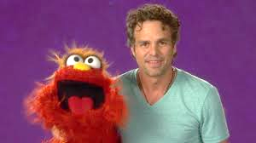
Empathy

Slide 3
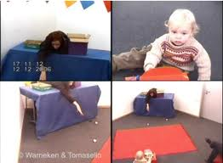
Altruism in Children
http://www.youtube.com/watch?v=aS-QLB8ELyk
http://www.youtube.com/watch?v=Z-eU5xZW7cU

Slide 4
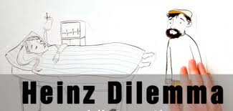
Kohlberg’s Levels of Moral Reasoning

Slide 5
Kohlberg’s Heinz Dilemma
In Europe, a woman was near death from a very bad disease, a special kind of cancer. There was one drug that the doctors thought might save her. It was a form of radium that a druggist in the same town had recently discovered. The drug was expensive to make, but the druggist was charging 10 times what the drug cost him to make. He paid $200 for the radium and charged $2000 for a small dose of the drug. The sick woman’s husband, Heinz, went to everyone he knew to borrow the money, but he could get together only about $1000, which was half of what it cost. He told the druggist that his wife was dying and asked him to sell it cheaper or let him pay later. But the druggist said, “No, I discovered the drug and I’m going to make money from it.” Heinz got desperate and broke into the man’s store to steal the drug for his wife.

Slide 6
Kohlberg’s Levels of Moral Reasoning
Preconventional morality: focus is on self-interest. Obey rules to avoid punishment or gain reward.
1) Avoids punishments – “Heinz’s father-in-law might make big trouble for him if he lets his wife die.”
2) Gains rewards – “Heinz will have someone to fix fine dinners for him if his wife lives.”

Slide 7
Kohlberg’s Levels of Moral Reasoning
Conventional morality: focus on caring for others and upholding laws and rules because they are the laws and rules.
3) Gains approval/avoids disapproval – “What would people think of Heinz if he lets his wife die?”
4) Does duty to support society/avoids dishonor or guilt – “Heinz must live up to his marriage vow of protecting his wife.”

Slide 8
Kohlberg’s Levels of Moral Reasoning
Postconventional morality: judgments are based on self-defined, ethical moral principles
5) Affirms agreed-upon rights – “Everyone agrees that people have the right to live.”
6) Abstract, autonomous moral principle – “Saving a life takes precedence over everything else, including the law.”

Slide 9
Eisenberg’s Levels of Prosocial Reasoning
“One day Mary was going to a friend's party. On the way, she saw a girl who had fallen down and hurt her leg. The girl asked Mary to go to the girl's house and get her parents so the parents could come and take her to a doctor. But if Mary did run and get the girl's parents, Mary would be late to the party and miss the fun and social activities with her friends.”
People then indicate what the person in the story should do, for example: “Mary should run and get the girl's parents,” “Not sure,” or “Mary should go to her friend's party.”

Slide 10
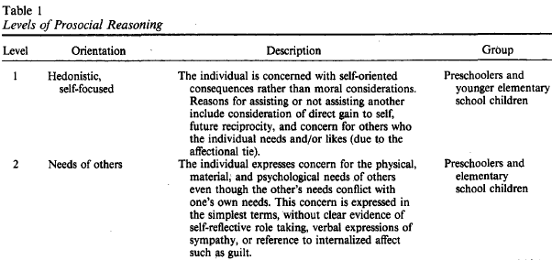
Hedonistic: “It depends how much fun Mary expects the party to be, and what sorts of things are happening at the party”)
Needs-oriented item: “It depends whether the girl really needs help or not”

Slide 11
Eisenberg’s Levels of Prosocial Reasoning
Stereotypic: “It depends if Mary thinks it’s the decent thing to do or not”
Approval: “It depends whether Mary's parents and friends will think she did the right or she did the wrong thing”

Slide 12
Eisenberg’s Levels of Prosocial Reasoning
Empathic/Transitional/Internalized: “It depends how Mary would feel about herself if she helped or not”

Slide 13
Prosocial Development: A Longitudinal Study
Eisenberg, Lennon
and Roth (1983)

Slide 14
The PROM
The Objective Measure of Prosocial Reasoning (Carlo, et al. 1992)

